Slide 1
Online Behavior

Slide 2
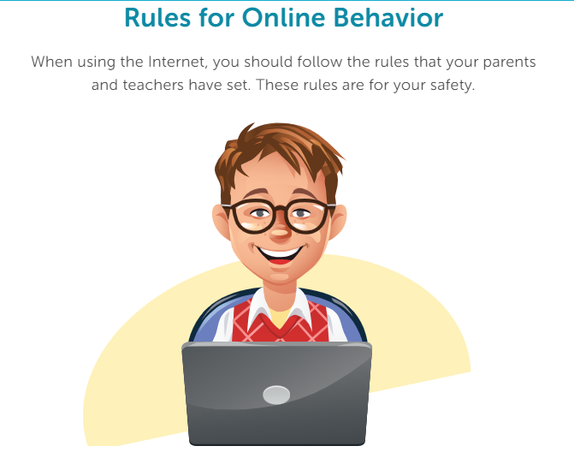

Slide 3
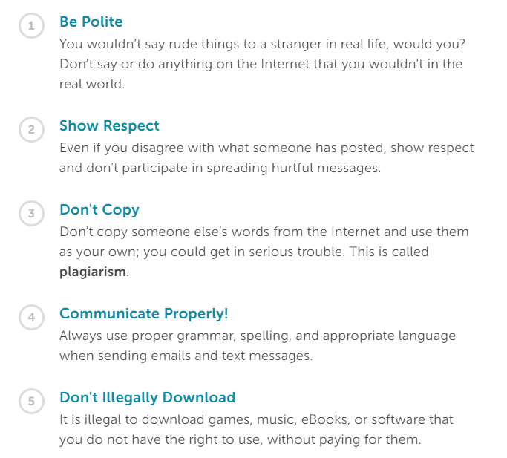

Slide 4
Complete Online Behavior Review Packet

